Slide 1
West Virginia Educator Effectiveness and Evaluation Systems
Regional Principal Institute
October 7th and 8th
RESA 6

Slide 2
Session Overview
Included Information . . .
  Policy 5310 Status
  Highlights of Educator Evaluation System
  Focused Support Plan (FSP) / Corrective Action Plan (CAP) Guidance
  Educator Effectiveness: Looking Ahead
Your questions will shape the session

Slide 3
Policy 5310: Status
September 10, 2015 – WVBE unanimously votes to table further action on Policy 5310 until October 14th State Board meeting.
Taskforce/Stakeholders will make a recommendation to WVBE based upon 2014-2015 evaluation data.

Slide 4
Evaluation System Components
Educator Self-reflection
Educator Goals
Educator Evidence
Educator Summative Evaluation

Slide 5
Why Do Educators Self- Reflect?
Take Ownership of Professional Growth
Establish an Understanding between Evaluator and Educator
  What are the expectations set for the educator?
  Has the educator met those expectations at the end of the year?

Slide 6
Self-Reflection: Myth vs. Fact
Myth: Administrator guides the teacher in Self-reflection.
Fact: Self-reflections are driven solely by the teacher.
Myth: Educators must revise their completed Self-reflections during the school year.
Fact: Self-reflections have proven to be one of the most beneficial components of the evaluation system.

Slide 7
Ensuring Meaningful Goals
S Specific
M Measureable
A Achievable
R Relevant
T Time-bound

Slide 8

Senate Bill 359:
Reading by 3rd grade
Policy 5310 contains the requirement for all PK-3rd grade teachers to focus one of their student learning goals on reading.

Slide 9
Educator Evidence
Who Collects the Evidence?
  Both the Evaluator and the Educator may
  collect evidence.
When is evidence required?
  If you rate yourself as distinguished.
  If your self-reflection differs from the opinion of your evaluator.
  When an “Unsatisfactory” rating is given.

Slide 10

Educator Evidence
Are Educators required to upload Evidence?
  No. The Evidence Form is intended to document Evidence to be verified.
How much Evidence is needed?
  Can be as simple as a description with date/time.
  Portfolios/Binders full of Documentation are NOT NEEDED!!
Notes:
Are educators required to upload evidence?
No. The online system does not function as a data portfolio and does not support the “uploading” of documents. The evidence form is intended to be used to document the types of evidence that has been or will be verified.
How much evidence is needed?
Evidence can simply be a date and name of an event that provides information on a particular professional standard or it can be any type of description of a teaching activity, etc. that informs an evaluator about a particular standard.
The intent of the educator evaluation system is to establish trust and collaborative conversations between educators and evaluators. It is not necessary to provide binders of information that may overwhelm the educator or the evaluator.
Now, at this time, I would like to turn it back over to Julie Sayre for further ideas from the field.
(CHANGE SLIDE)

Slide 11
Summative evaluation
Notes:
Putting the pieces together for the end-of-year summative evaluation.

Slide 12
End of Year Procedure
What is the appropriate procedure for Summative Evaluations at the end of the year?
Evaluator and educator conduct Summative Evaluation Conference.
Evaluator finalizes the Summative Evaluation prior to close of the school year.

Slide 13
End of Year Procedure
3. Educator accepts the Summative Evaluation prior to the end of the school year. Educator may also add addendum to evaluation at this time.
4. School-wide growth data is inserted into system during the fall of the next school year.
5. Educator finalizes their evaluation after growth data is available.

Slide 14
Plans for Continuous Support

Slide 15
When is a Focused Support Plan Needed?
Area of concern identified
At least one (1) observation is complete
Support for struggling educator is needed
Proactive, preventative measures can be implemented
Notes:
When should the FSP be considered?
To be PROACTIVE AND PREVENTATIVE in nature, the FSP should be used in situations when the evaluator believes that a educator’s performance related to one or more of the standards is weak.
The performance is not yet unsatisfactory. The FSP is designed for use in this situation.

Slide 16
Focused Support Plan Components
Area of concern/standard(s) identified
Expectation for change
Purposeful conversation between evaluator and educator
9 week timeline for implementation
Specific resources for support
Notes:
WHAT are the essential components for inclusion in the FSP plan?
Outline the Resources for support, including referral to other educators
Other Types of Support Resources:
Professional Development
Coaching/Instructional support
Mentoring
Peer observation
Programs of study
Other supports & resources

Slide 17
Focused Support Plan
Conclusion of Nine Week Plan
Does evidence demonstrate—
Standard met? Remove from the FSP
Adequate progress? Implement another Focused Support Plan
Inadequate progress? Move to a Corrective Action Plan
Notes:
WHAT OCCURS AT THE END OF THE 9 WEEKS?
At the conclusion of the nine-week focused support plan, if evidence demonstrates that the standard has been met, then the plan is successfully completed.
If evidence demonstrates that adequate progress has been made, the focused support plan will continue for a second nine-week period.
If there is inadequate progress on the standard related to the area of concern, an evaluation will be completed and a corrective action plan will be initiated.

Slide 18
When is a Corrective Action Plan Needed?
At least one (1) observation is complete
Inadequate progress on Focused Support Plan (if applicable)
Unsatisfactory performance determined on Summative Evaluation
Misconduct that requires immediate action (W. Va. Code §18A-2-8) and/or a CAP
Notes:
WHEN? The second type of supportive, improvement plan is the Corrective Action Plan (CAP)
The corrective action plan is typically initiated when a focused support plan shows there was inadequate progress and when an evaluation is completed that shows unsatisfactory performance based on one or more of the performance standards.
However, certain instances of misconduct as specified in W.Va. Code §18A-2-8 may require immediate action and/or a corrective action plan.

Slide 19
Corrective Action Plan
Components
  Unsatisfactory performance with reference to the standard(s) to be addressed
  Expectations for change
  18 Week timeline for implementation
  Specific resources for support
Notes:
WHAT are the essential components for inclusion in the CAP plan?
Here are the Essential components of a Corrective Action Plan:
Identified area of unsatisfactory performance with reference to the standard(s) to be addressed
Expectations for change (use process similar to S.M.A.R.T.)
Timeline for implementation
Resources for support
18 Weeks on the CAP is required.

Slide 20
Corrective Action Plan
Conclusion of 18 Week CAP
Does evidence demonstrate—
Standard met? CAP successful
Standard not met? CAP may not be repeated.
  Personnel action required.
Notes:
WHAT OCCURS AT THE END OF THE 18 WEEKS?
The corrective action plan spans 18 weeks and may commence at any time during the school year.
The corrective action plan is determinative and may not be repeated.
Evidence of adequate progress must be demonstrated by the conclusion of the 18-week corrective action plan.
Evidence does not demonstrate that adequate progress has been made at the conclusion of the 18-week period, termination for unsatisfactory performance shall ensue.

Slide 21
Educator Effectiveness:
Looking Ahead

Slide 22
Where we are going…
  Enhancing alignment between professional learning, eLearning and the WV Educator Evaluation System
  Developing teacher leaders by creating career ladders/lattices
  Re-designing Certification & Licensure Structure
  Completing & Publishing the Professional Growth Guides
  Developing one-stop-shop for teachers
  Increasing opportunities for connecting alike needs (through PLC and Skype platforms)
17

Slide 23
WV Professional Growth Guides
Teachers | Principals
Collect specific examples of Best Practices within each of the Professional Teaching Standards | Collect specific examples of what to look for during observations of teachers
Discover solutions to difficulties commonly experienced | Have a comprehensive list of support/PD materials which may be offered to an educator
Have a comprehensive list of PD materials/ resources which are aligned for improvement within the standard
13

Slide 24
WV Professional Growth Guides
http://wvde.state.wv.us/evalwv/guidance-documents.html
13

Slide 25
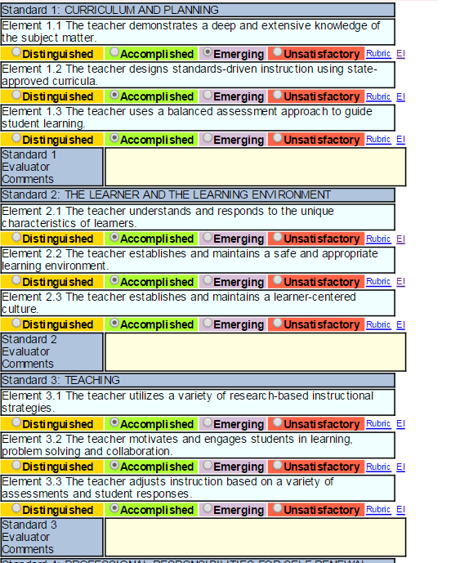
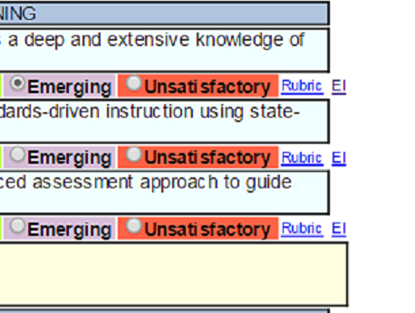
Embedded PD Mock-up
The EI Links take the educator to their personalized PD Plan.
10

Slide 26


Slide 27
Thank You!
Trent Danowski
tdanowski@k12.wv.us
Lori Buchanan
llbuchan@k12.wv.us

